Slide 1
SPEECH EMOTION RECOGNITION
GUIDE: JOSIKA P
MS.R.L.JASMINE 2019202020
MCA-R

Slide 2
INTRODUCTION
Speech emotion recognition
Convolution Neural Network(CNN)
Raw audio to gender based emotion
7 emotions from audio
CNN from mel-spectrogram image
Deep learning techniques

Slide 3
MOTIVATION
Speech is a rich form to express emotions.
To find emotions using the vocal tones.
Deep Learning method to be used.
OBJECTIVE
Using CNN to find emotions.
Comparing 1D CNN and 2D CNN.
Total of 7 emotions to be found.

Slide 4
LITERATURE SURVEY
S.No. | Author name & Paper title | Concept in the paper | Findings
1. | TITLE:Speech Emotion Recognition using Deep Learning AUTHOR: Nithya Roopa S., Prabhakaran M, Betty. | IEMOCAP corpus Database Inception Net v3 35.6% accuracy | Transfer learning model GoogLeNet Architecture Resize and spectrograms Inception net v3
2 | TITLE:Speech Emotion Recognition using CNN AUTHOR:Ansari, Abdul Ajij and Singh, Ayush Kumar and Singh, Ashutosh | RAVDESS CNN 35.6 % accuracy | How to use CNN Integrating Datasets Machine learning algorithms

Slide 5
LITERATURE SURVEY
S.No. | Author name & Paper title | Concept in the paper | Findings
3 | TITLE:Emotion recognition in speech using MFCC and wavelet features AUTHOR:K.V. Krishna Kishore; P. Krishna Satish | SAVEE DATASET MFCC Gaussian Mixture Model (GMM) 51% accuracy | MFCC feature extraction method Wavelet Analysis
4 | TITLE:Speech emotion recognition based on a modified brain emotional learning model AUTHOR:Sara Motamed , Saeed Setayeshi , Azam Rabiee | Berlin Dataset of Emotional Speech MLP MFCC and LPC(linear predictive coding) 53% accuracy | 3 emotions details Happiness,sad,anger Different models

Slide 6
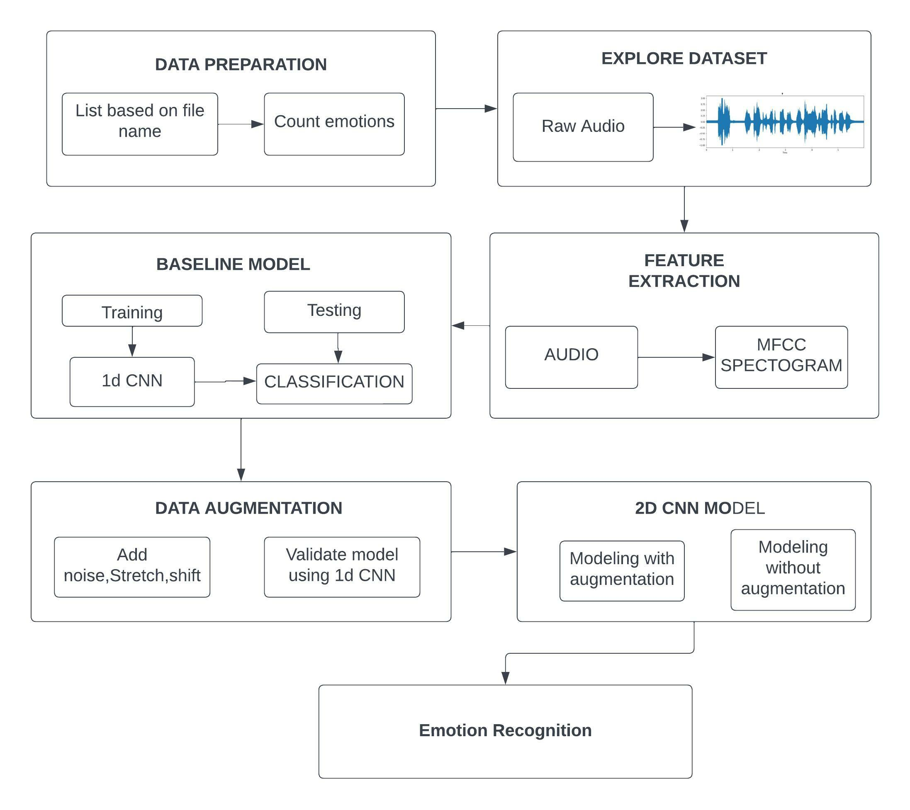
OVERALL ARCHITECTURE

Slide 7
LIST OF MODULES
Data preprocessing
Feature Extraction
Baseline Model
Data Augmentation
2D CNN Classification model

Slide 8
MODULES DESCRIPTION
DATA PREPROCESSING:
Explore audio files
Plot based on time , amplitude
Check fluxuations
FEATURE EXTRACTION:
Fast fourier transform
Mel filter bank
Plot MFCC band based on time
Store values in array

Slide 9
BASELINE MODEL:
Split for training and testing
1D CNN model
Save model
DATA AUGMENATATION:
Add speed,noise
Split for training and testing
1D CNN model
Find accuracy
2D CNN MODEL:
2D CNN with augmentation
2D CNN without augmentation
2D CNN with Log-Melspectrogram

Slide 10
DATASET DETAILS
Ryerson Audio-Visual Database of Emotional Speech and Song (RAVDESS)
RAVDESS contains 1440 files.
Surrey Audio-Visual Expressed Emotion (SAVEE)
Savee contains 480 samples.
Toronto Emotional Speech Set(TESS)
There are 2800 data points (audio files) in total.
Crowd Sourced Emotional Multimodal Actors Dataset(CREMA-D)
CREMA-D is a data set of 7,442 original clips from 91 actors.

Slide 11
ALGORITHM 1: MFCC Feature Extraction
Input: Audio Wave Images.
Output: MFCC
Function MFCC (parameters)
Initialize parameters.
Split into frames.
Apply Hanning window to the frames.
Get spectrum by applying fast fourier transform to all frames.
Determine matrix for melspaced filter bank.
Transform spectrum to melspectrum.
Obtain MFCC vector for each frame by applying discrete cosine transform.
end function

Slide 12
ALGORITHM 2:CNN
INPUT:Audio Images
OUTPUT:Predicted output
#Defining the model
Sequentialmodel(Convolution2D,Pooling,Dense,Activation)
Input image shape for different convolutions
Add 2D convolutions with 32 filters and size 3*3 until filter reaches 64
Perform sigmoidal and relu activations till dense reached 64 layers
Involve mask of size 2*2 through max pooling
Hyper tune to avoid overfit
Add fully convoluted dense class
Softmax activation
Defince accuracy metric and compile

Slide 13
#View model_configuration
Sequentialmodel(get_config,get_weights)
View generated model configuration
View model input and output shape
Assign weights to individual layers
Model is ready to train
#Training
Perform model fitting using batch-size and epochs
Validation of data tested till training complete
#Visualize loss and accuracy
Visualize model loss and validation loss with the obtaine accuracy

Slide 14
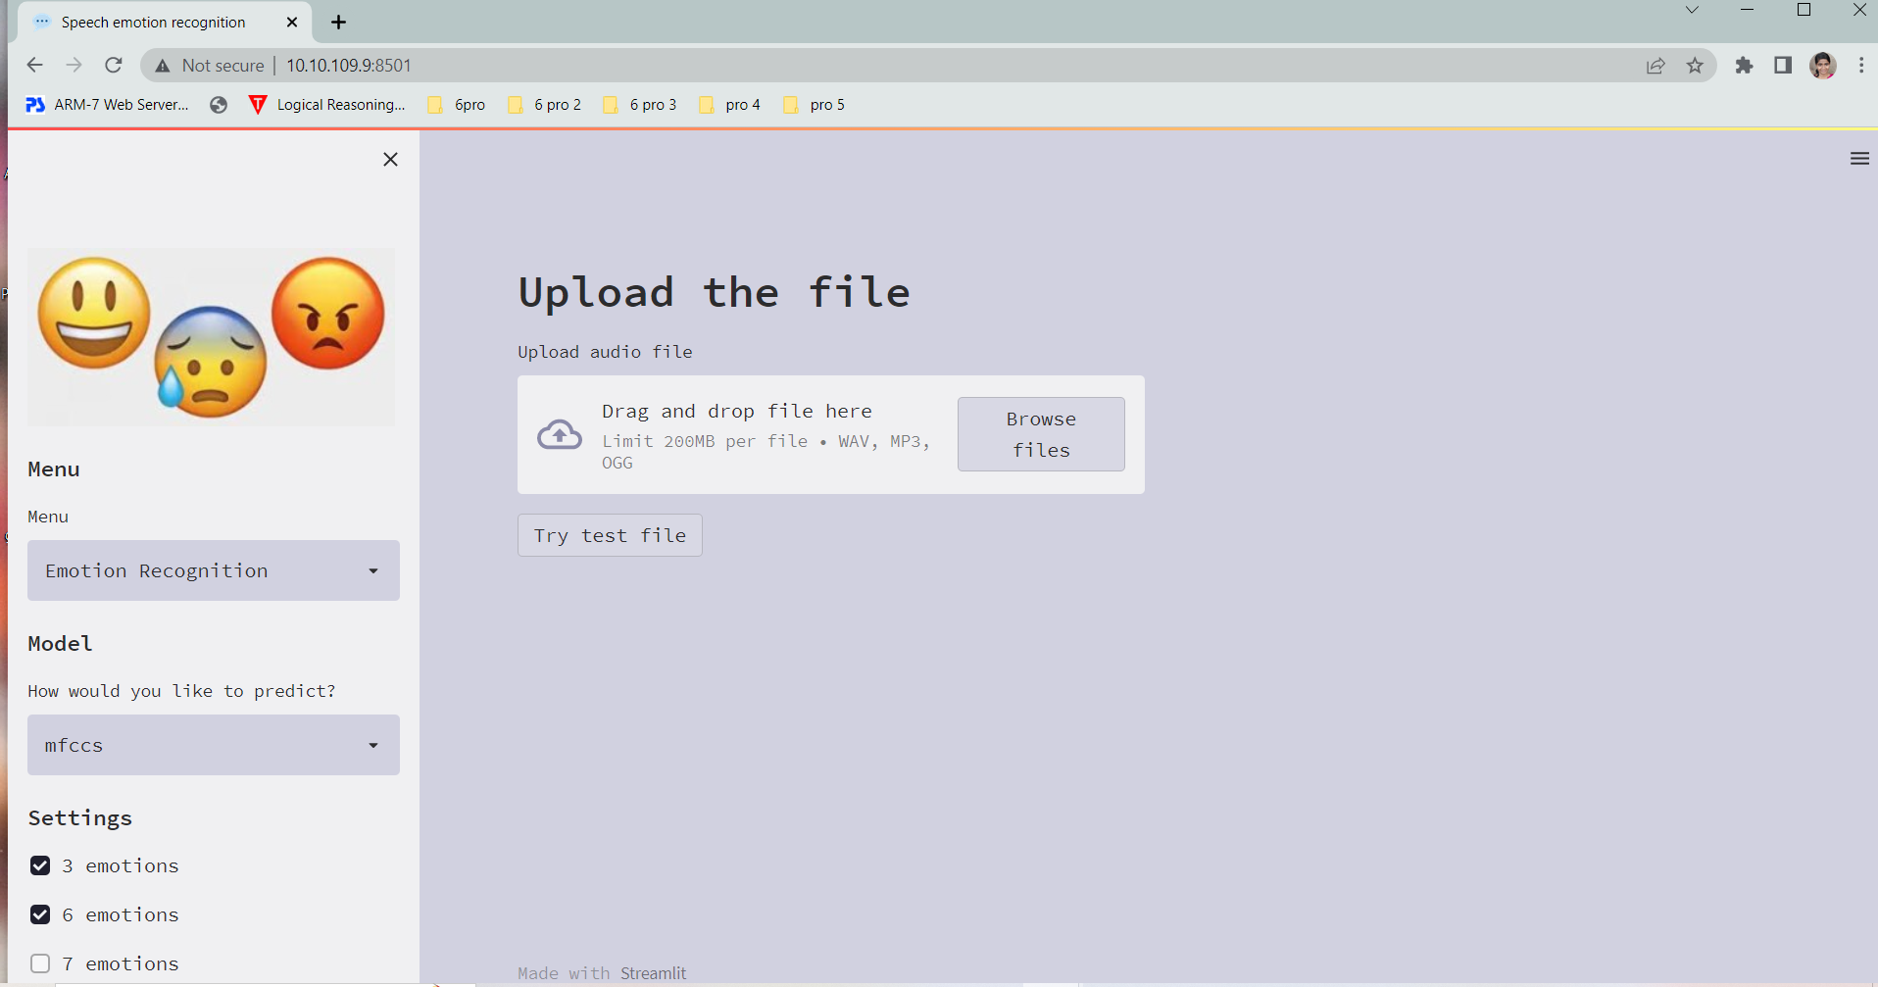
IMPLEMENTATION SCREENSHOTS

Slide 15
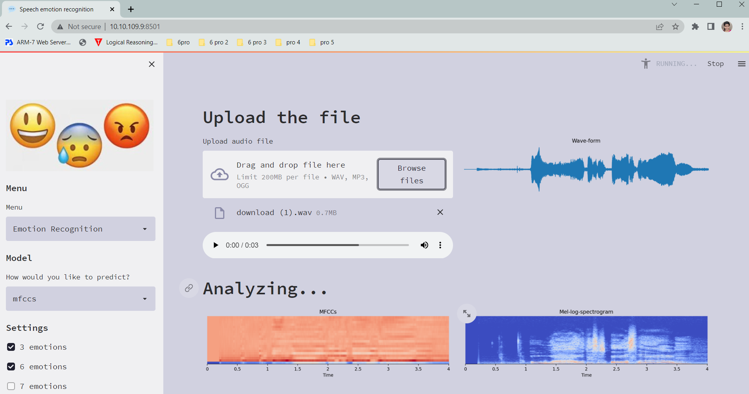
UPLOADING AN AUDIO FILE

Slide 16
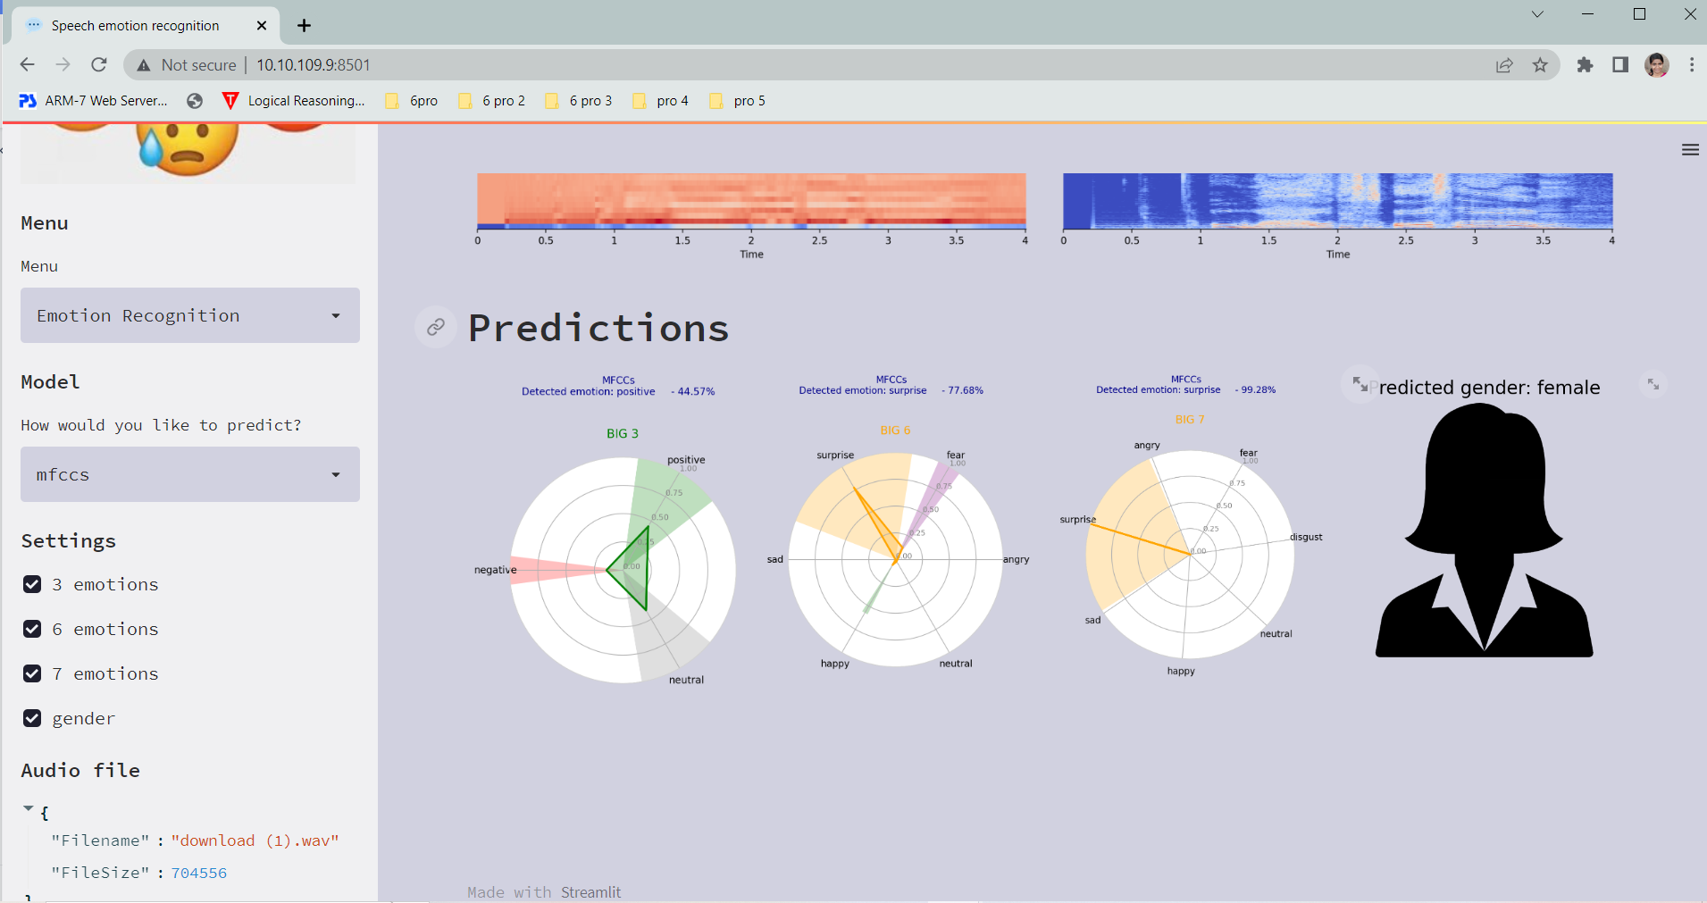
PREDICTIONS USING SAVED MODEL

Slide 17
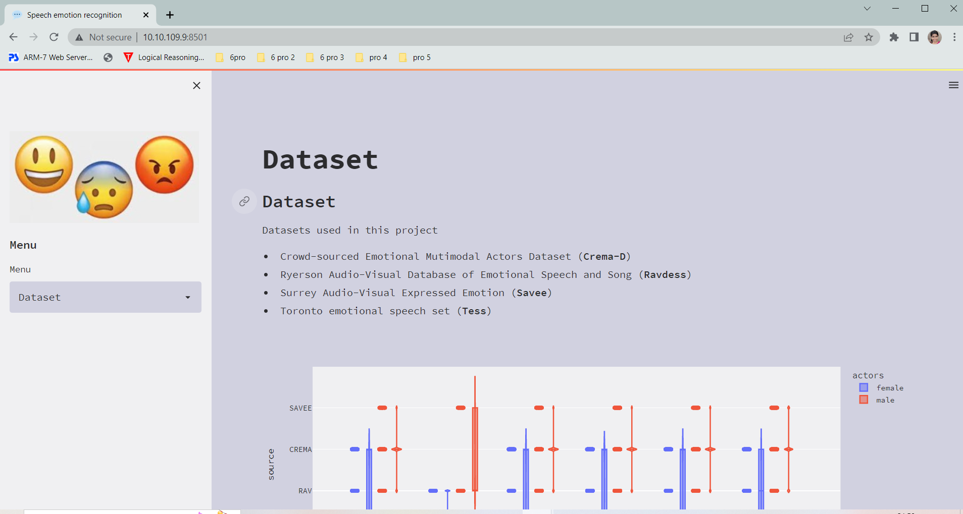
DATASET DETAILS

Slide 18
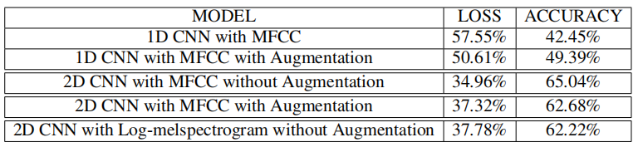
PERFORMANCE ANALYSIS

Slide 19
CONCLUSION
Done with multiple CNN models
Compared MFCC and Log-melspectogram
2D CNN with data augmentation -high accuracy
MFCC feature extraction performed well
In future we can integrate with customer related application

Slide 20
REFERENCES
[1] Roopa, S., Prabhakaran, M., & Betty, P. (2019). Speech emotion recognition using deep learning. International Journal of Recent Technology and Engineering, 7, 247-250.
[2]Ansari, A., Singh, A., & Singh, A. (2020). Speech Emotion Recognition using CNN. International Research Journal of Engineering and Technology (IRJET),7,p-ISSN: 2395-0072
[3] Kishore, K., & Satish, P. (2013). Emotion recognition in speech using MFCC and wavelet features. In 2013 3rd IEEE International Advance Computing Conference (IACC) (pp. 842–847).
[4] Sara Motamed, Saeed Setayeshi, & Azam Rabiee (2017). Speech emotion recognition based on a modified brain emotional learning model. Biologically Inspired Cognitive Architectures, 19, 32-38.

Slide 21
THANK YOU

